Slide 1

State of the “Enterprise”
Web 2.0 Trends

Slide 2
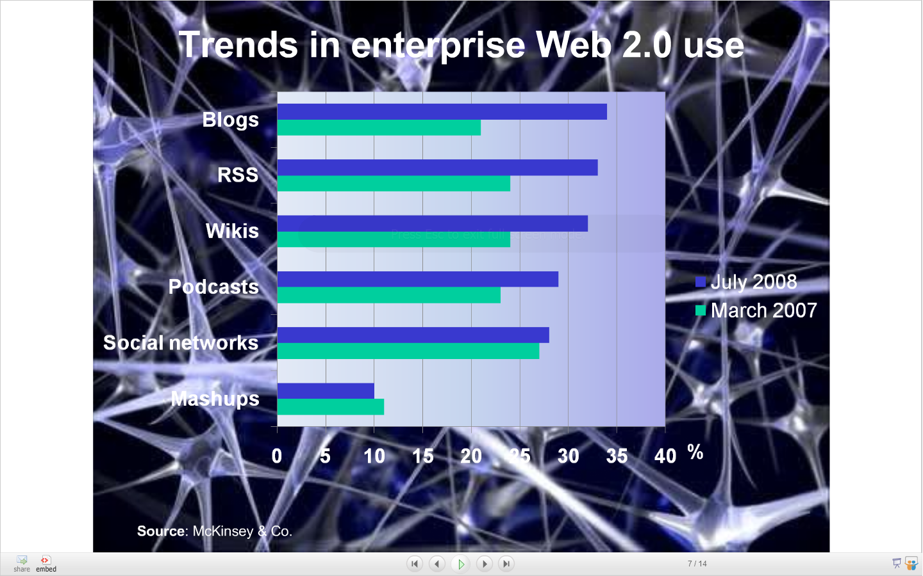

Slide 3
Productivity & Efficiency | Increased productivity
 | Faster innovation & product dev
 | More efficient project mgmt
 | Reduced email overload
 | Improved team performance
Staff Engagement | Better internal communication
 | Greater staff engagement
 | Enhanced collaborative behavior
 | More effective learning & develop
Knowledge | Easier access to expertise and organization capabilities
 | Enhanced search
Reputation | Attractiveness as an employer
 | Improved firm reputation
 | Increased visibility in the market

Slide 4
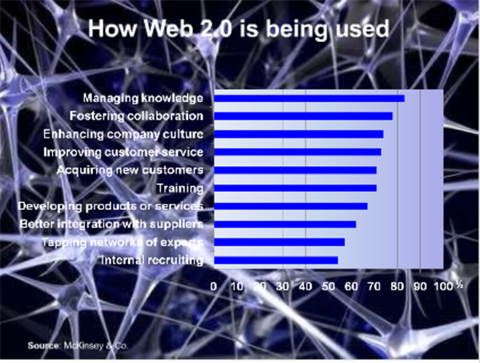

Slide 5
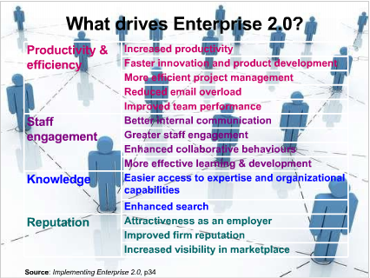

Slide 6
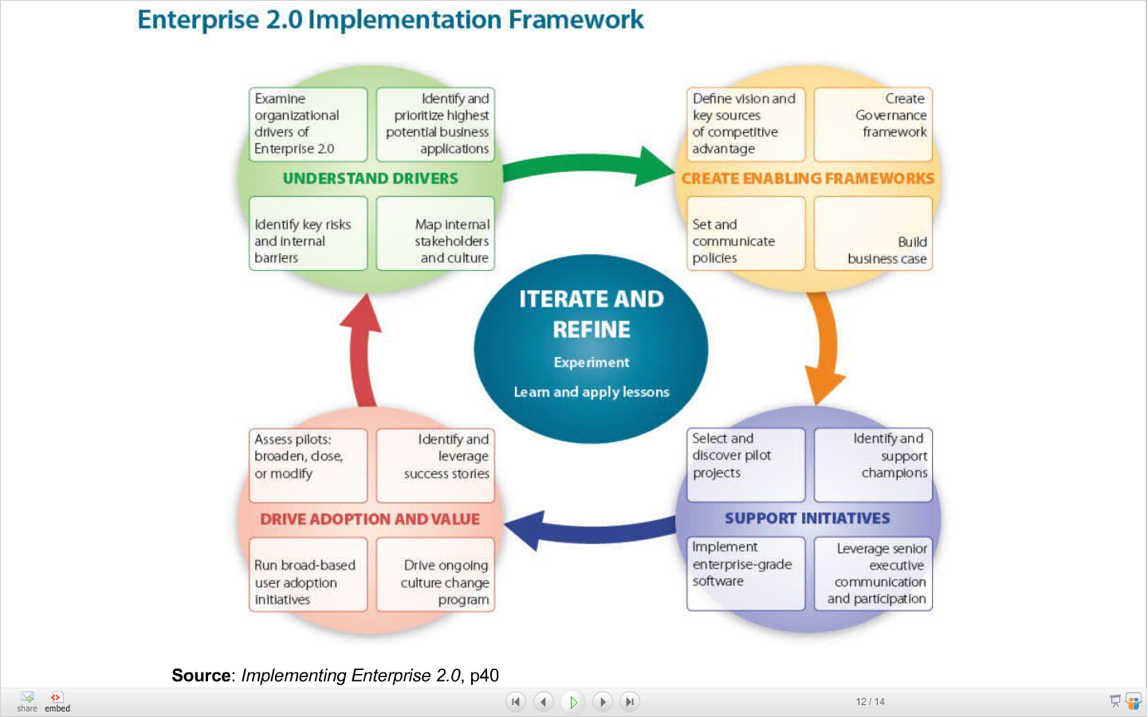

Slide 7
